Slide 1


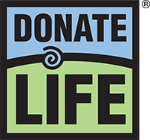

Slide 2

Let’s Explore Kidneys!
Notes:
Let’s get started by discussing our kidneys.

Slide 3
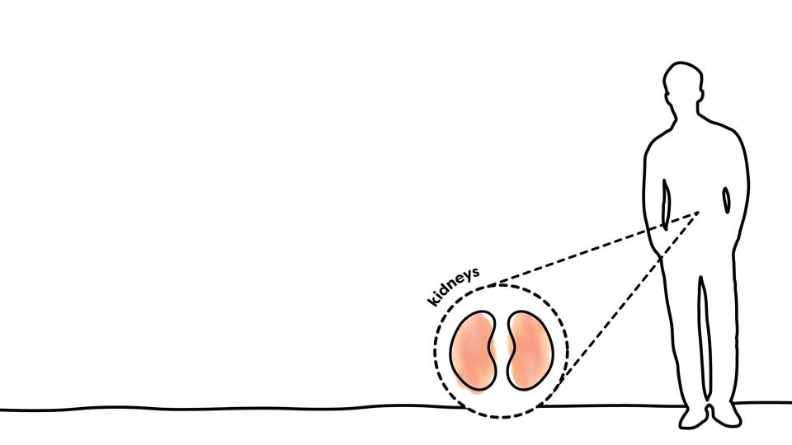

What are kidneys?
Two bean-shaped organs, each about the size of your fist
Each contain a million nephrons
Every nephron has a filtering unit called a glomerulus that is made of tiny red blood vessels
Notes:
Most people are born with two kidneys, and each are about the size of your fist. They live in your back, just below your ribcage. Inside your kidneys are a million nephrons, each with its own filtering unit. This filter, called a glomerulus, is made of tiny red blood vessels.

Slide 4

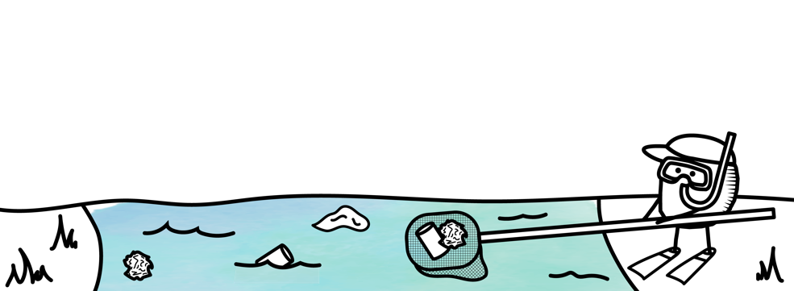
What do kidneys do?
Filter and remove waste, toxins and excess fluid from your body
Balance your body’s fluids
Release hormones that regulate blood pressure
Produce a form of vitamin D that promotes strong, healthy bones
Control the production of red blood cells
Notes:
The kidneys have a lot of jobs, but they are most known as filters that remove waste, toxins and excess fluids. Picture them like the little graphic below, fishing waste out of your blood so that clean blood can return to circulation. Kidneys are in charge of regulating your blood pressure, producing a form of vitamin D that keeps your bones strong, and controlling the production of red blood cells.

Slide 5

How do kidneys work?
Filter blood when it comes into the glomerulus
Clean blood goes back into circulation
Waste fluids turn into urine
Notes:
How do your kidneys work? Basically, blood enters your kidneys and is cleaned through their filters. Clean blood returns to circulation, and the waste fluid turns into urine. Can you imagine if your kidneys didn’t work and this waste stayed in your body? For some people, this is a reality. It’s easy to take a natural thing like peeing for granted, but it may not be possible for people in kidney failure.

Slide 6
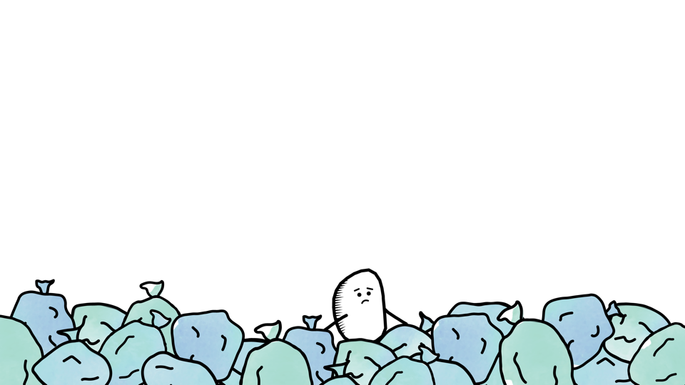

Why are kidneys important?
They are essential to human life!
Kidneys filter close to 50 gallons (200 liters) of fluid every day
If kidneys stop working, this waste is unable to be removed, and it will start to build up in your body
When a person’s kidneys don’t work, it’s called chronic kidney disease
Notes:
The kidneys are so important that a person cannot live without them. Kidneys need to function around the clock to filter nearly 200 quarts of fluid every single day. When kidneys stop working like they’re supposed to, it’s called chronic kidney disease. You may know someone who has chronic kidney disease, since it is sadly not common.

Slide 7


Why should I care about kidney health?
One in every seven adult Americans
have chronic kidney disease
People are at increased risk for
chronic kidney disease if they
have any of the following:
  Diabetes
  High blood pressure
  Heart disease
  Obesity
  Family history of kidney disease
  Certain groups: African Americans, Hispanics, Pacific Islanders, American Indians and Seniors
Notes:
In fact, about one in every seven adults in America have chronic kidney disease. Some conditions can put a person at more risk. Diabetes is the leading cause of kidney disease, followed by high blood pressure. Heart disease, obesity, being a racial or ethnic minority, and having a family history of kidney disease can also put a person at higher risk. It’s important to ask if these conditions run in your family. If so, your adult relatives should talk to their doctor about their kidney health.

Slide 8
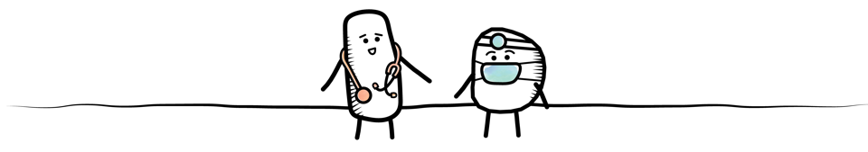
How do doctors find kidney disease?
Urine test to check for protein in the urine
Blood test to see how well the kidneys are filtering blood
Adults with one or more risk factor should be tested
each year at their annual physical
Notes:
There are two easy tests that doctors use to see if a person has kidney disease. One is a urine sample to check for protein in the urine. People should not have protein in their urine, so its presence is a sign that something may be wrong. Also, a blood test can show how well a person’s kidneys are filtering their blood. These tests should be done every year for people who have one or more risk factor for kidney disease.

Slide 9

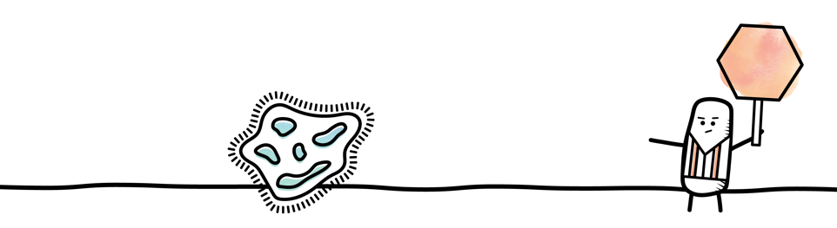
Is there a cure for kidney disease?
No, there is no cure
However, treating kidney disease early helps to slow or stop its progression
Prevention is important!
Kidney disease can lead to kidney failure
When too much damage has been done to the kidneys,
dialysis or a kidney transplant are the treatment options.
Notes:
It’s important to try to prevent kidney disease or catch it early at an annual check-up. There is no cure for kidney disease, but early treatment can slow it down and sometimes stop it entirely. Kidney disease can lead to kidney failure.

Slide 10

Diving Into
Dialysis, Transplant and Living Donation
Notes:
We’re going to dive right in and discuss the ways that kidney failure can be treated.

Slide 11

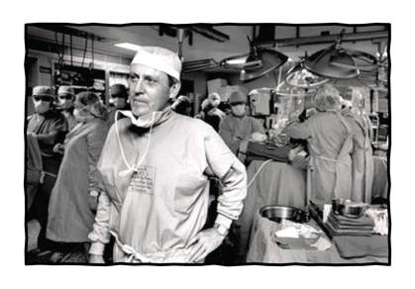
First, A Little History
1954 – first kidney transplant
between identical twins
1960 – first dialysis treatment
  Due to the large need but limited
  availability, a committee was formed
  to determine who would receive dialysis
1963 – Dr. Thomas Starzl discovered
how to prevent organ rejection
Dr. Starzl performs one of the first transplants in 1967.
Notes:
But first, let’s talk about the early days of treatment for kidney failure. Back in 1954, a plastic surgeon in Boston named Joseph Murray performed the first successful kidney transplant. It was between 23-year-old identical twin brothers. The recipient lived for eight years, and his death was unrelated to the transplant. His twin, the living donor, died nearly 56 years later.
In 1960, the very first patient went through a kidney treatment called dialysis. There were many people who needed dialysis but not enough machines available. A committee was formed to decide who would receive dialysis, essentially determining who would live and who would die. Could you imagine being given that responsibility?
In 1963, Dr. Thomas Starzl discovered how to prevent organ rejection. Any time a person has something foreign in their body, such as a splinter, the body’s immune system works to fight it. The same thing happens when people were given a new organ. Their body knows it isn’t their DNA, so it attacks the new organ and destroys it. Dr. Starzl figured out how to prevent organ rejection by creating medicines called immunosuppression, which suppress – or weaken - the immune system. Because of his discovery, Dr. Starzl became a very famous surgeon.

Slide 12


Nowadays
Dialysis is widely available
– even from home
About 500,000 Americans
are currently undergoing
dialysis treatment
Transplants happen every
day across the U.S.
About than 500,000 people
have received a kidney
transplant to date
Notes:
Now, dialysis is fortunately widely available. A committee no longer decides who will receive this treatment. There are dialysis facilities across the country, and many patients even do dialysis at their homes. About a half a million Americans are currently on dialysis because their kidneys have failed.
Successful kidney transplants continue to be performed every day, and about 500,000 people have received a kidney transplant in the U.S.

Slide 13

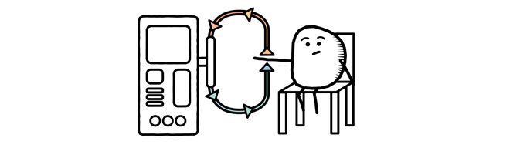
Kidney Dialysis Basics
Filters the blood, cleans it, and returns it to the body
Takes many hours each week
One tenth as effective as a human kidney
Can lead to other health problems
Notes:
Do you know someone who is on dialysis, or have you seen it in a movie or TV show? In this graphic, you can see a basic depiction of how dialysis works. A person is hooked up to a machine that slowly removes their blood, the dialysis machine cleans it, and their cleaned blood returns to their body. Typically, people go to a dialysis center three times a week, and they are connected to the dialysis machine for about four hours every time. There are also other options. Some people do dialysis every day at home, or sleep connected to a dialysis machine. No matter what method of dialysis a person chooses, it is not an easy way of life. People often don’t feel well when they are on dialysis. They also have a very strict diet and must keep track of how much fluid they have each day. Dialysis can also lead to other health problems. This is mainly because the dialysis machine simply isn’t as good as a human kidney. In fact, a dialysis machine can only do about 10% of what a human kidney can do. Since dialysis has so many drawbacks, transplant is the preferred treatment for kidney failure.

Slide 14



Kidney Transplant Basics
A transplant surgeon removes a healthy kidney from a donor and transplants it into a person with kidney failure
About 100,000 people are
waiting for a kidney transplant
in the U.S.
The shortage of donors means
a person could wait five years
or more for a kidney
Patients with a living donor
don’t need to wait for a
deceased donor
Omar received a living-donor kidney transplant from his friend, Clay.
Notes:
During a kidney transplant, a transplant surgeon removes a healthy kidney from a donor and connects it into a person with kidney failure. Usually the transplant surgeon leaves a person’s original kidneys in their body. The surgery is less invasive, and the recovery time is faster, if a person’s native kidneys are left alone. Plus, most of these kidneys still have a little bit of function left, even if they are working at only 8 or 10%. Most people who have had a kidney transplant are walking around with 3 kidneys!
There is a huge demand for organ transplants, but a very small supply. Because of this, about 100,000 people in the U.S. are waiting for a kidney transplant. On average, people must wait for more than 5 years before a deceased donor kidney becomes available. However, if a patient finds a living donor, they can skip this long wait and receive a transplant as soon as their living donor has been evaluated and approved.

Slide 15

Living-Donor Kidney Transplant Basics
Most people are born with two kidneys and can donate their spare
People can live a full, healthy life with just one kidney
Living-donor kidneys are the preferred treatment option for someone in need of a transplant
Notes:
Living donation is a way for a living person to save someone who is in kidney failure. Most people are born with two kidneys, but they only need one kidney to lead a full, healthy life. So, some people decide to share their spare kidney with someone in need. Living donor kidneys usually work better and last longer than kidneys from deceased donors, so they are the preferred treatment option.
Living donors must complete a thorough evaluation so that a team of doctors can determine if living donation is a safe option. In fact, living donors must be so healthy in order to donate that they live LONGER than the general population. Living donors have a minimally invasive surgery to remove their spare kidney. The waiting recipient is usually in an operating room right next to their living donor so that the donor’s kidney can immediately be transplanted. After being a living donor, there are no changes to the person’s diet or lifestyle.

Slide 16

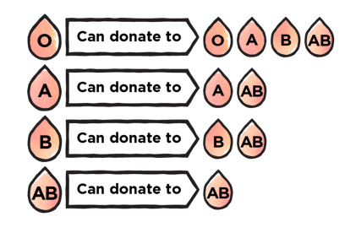
Matching Blood Types
In addition to blood types, compatibility is needed between antigens and antibodies
A transplant can happen even
if the donor’s blood type isn’t
the same as the recipient’s
A crossmatch is performed to determine if organ rejection is likely to occur
Notes:
Before moving forward with any type of transplant, the medical team must make sure that the donor and recipient are a match. When it comes to the kidneys, the blood types, antigens and antibodies must all be compatible. Even if a person has a different blood type, they might still be compatible. Blood type O is the universal donor, and blood type AB is the universal recipient. Antigens are small proteins on the surface of your cells that are used as markers to match compatible donors with recipients. If you’ve ever heard of a perfect match, it means that the donor and recipient matched 6 out of 6 antigens. A donor doesn’t have to be a perfect match, but they at least have to have enough antigens in common that their kidney will get along in the recipient’s body. Antibodies are proteins that your body makes any time it feels threatened. When the body detects something that shouldn’t be there, it makes antibodies to go out and fight. Some people have more antibodies, meaning that they are more sensitive and will match with fewer donors. When there is a donor available, doctors do something called a crossmatch. You can think of it as a transplant in the test tube. They take a small sample of the donor’s blood and mix it with a small sample of the recipient’s blood. In some cases, the blood samples get along just fine. This is called a negative crossmatch, and it means there is a lower chance of the recipient rejecting the donor’s organ. In other cases, the two blood samples attack each other. This is called a positive crossmatch, and we need to avoid this because it means there is a higher chance of the recipient rejecting the donor’s organ.

Slide 17


Paired Donor Exchange
One in three living donor/recipient
pairs are incompatible
However, if blood types are
incompatible, paired donor
exchange is an option
Notes:
Sometimes a donor is compatible with their intended recipient. When this happens, the kidney can be donated directly from the living donor to the recipient. In other cases, the donor is not a match for the recipient. This used to be very devastating news. Think about how hard it would be to find out that you aren’t a match for the person whose life you want to save. Fortunately, there is now a way to arrange for these kidney transplants to still happen. It’s called a paired donor exchange, but people also call them kidney swaps. You can see in this picture that a mom wants to donate to her son, but she’s not a match. In another family, there is a husband who wants to donate to his wife but he’s not a match. In this example, the mother is a match for the wife, and the husband can donate to the son. Through paired donor exchange, the kidneys can be swapped so that two people donate kidneys, two people receive kidneys, and everyone goes home happy.

Slide 18
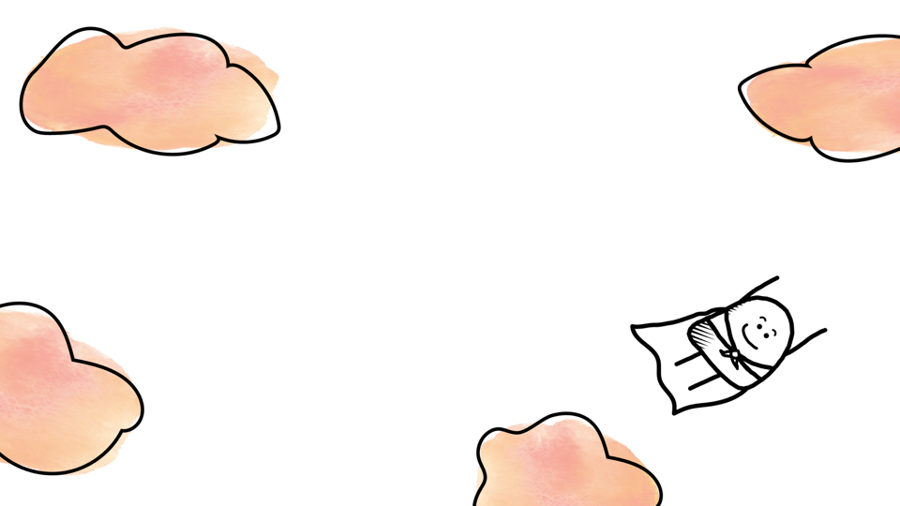
Living Donor Heroes
Notes:
Living donors save lives every day in America, and for that reason, many people think of them as heroes.

Slide 19


Heroes Among Us
Whether they donate to a specific
person (“directed donation”) or to anyone
in need (“non-directed donation”),
living donors are heroes
They give something much more valuable
that time or money – they give life!
They know that their main motivation
must be an unselfish desire to help a
person in need
They know that no financial
compensation is allowed – it is illegal in the US to buy or sell organs
Luke (living donor) and his wife Kristen (recipient) were part of a paired kidney donation.
Notes:
The act of stepping forward to share an organ with someone else in organ failure is a heroic one. It is a beautiful thing to give the gift of life. Living donors must freely decide that they want to donate an organ. Part of the evaluation process is to ensure that the living donor has an unselfish desire to help the person in need. They can’t be forced into it, and they can’t do it for any personal gain. In fact, buying and selling organs in the US is illegal and is a felony.

Slide 20


Benefits of Living-Donor Kidney Transplant
People only need one kidney and can lead a long, full life after
being a living-kidney donor
This type of transplant increases the recipient’s life expectancy
Transplants happen when the recipient is heathiest
The surgery can be timed conveniently for the donor
It can reduce the length of hospitalization
Living donor kidneys last longer
Notes:
A living donor benefits by being a hero for someone in organ failure. They can live a long, full life with only one kidney. The recipient also benefits from having a living donor. Recipients with a living donor transplant have a longer life expectancy than those who have a deceased donor transplant. These surgeries are also scheduled for when the recipient is their healthiest and can be timed to be convenient for all parties. Recipients are in the hospital less when they have a living donor kidney. But perhaps the biggest benefit is that living donor kidneys last longer.

Slide 21


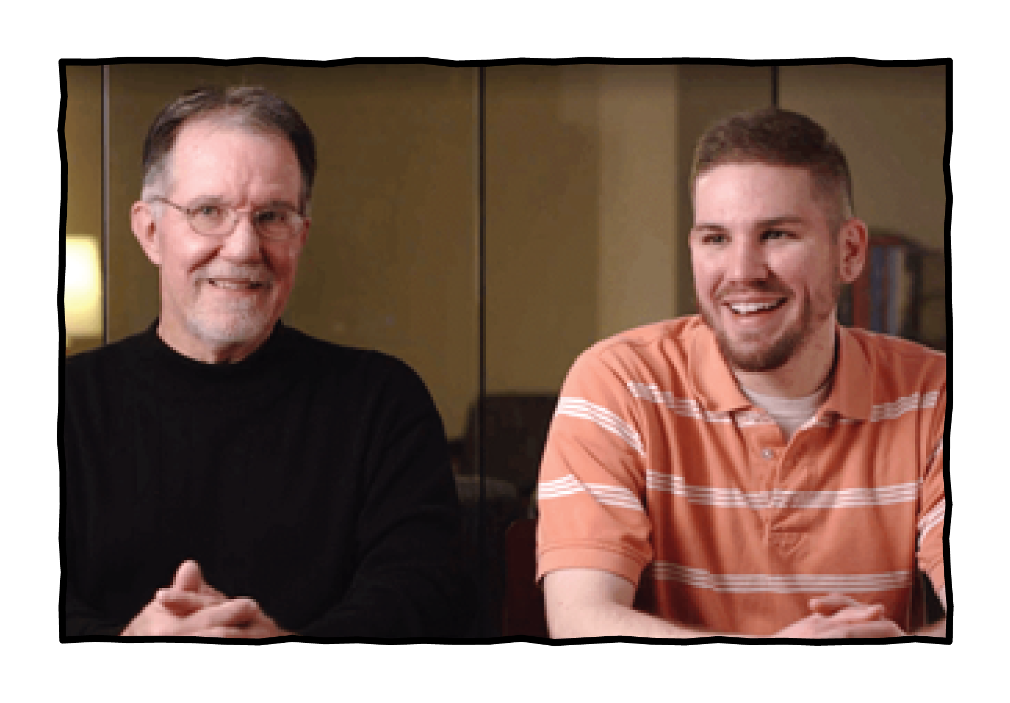
Living-Donor Kidneys Last Longer
On average, a deceased-donor kidney lasts from 8-12 years
By comparison, living-donor kidney transplants last on average from 12-20 years
Shelley donated a kidney to her co-worker’s husband, Reggie.
Ken received a life-saving kidney donation from his nephew, Frank.
Notes:
On average, we expect a kidney from a deceased donor to last 8-12 years. By comparison, living donor kidneys last an average of 12-20 years. That’s a really big difference!

Slide 22

Who Can Be a Living Donor?
To be a living donor, you must:
  Be between the ages of 18 and 75
  Be in general good health
  Be willing to donate
It is not necessary for the donor to have the same blood type as the recipient
UPMC will determine if a person is able to be a donor
If a person is not a perfect donor, they are not allowed to donate an organ
Rachelle (living donor) and her husband Mike (recipient) celebrate a second chance at life.
Notes:
Adults between the ages of 18 and 75 may be a living donor. Donors must be in good general health. But the most important factor is that the donor must be willing to donate. Remember that it’s not important for a living donor to be compatible with the recipient, since paired donor exchanges happen every day. It is the hospital’s job to decide that a person is able to be a donor. At UPMC, the rule is that either a person is a perfect donor, or they’re not a donor at all. Protecting the health of the donor is a top priority, which is why there is such a thorough evaluation process.

Slide 23

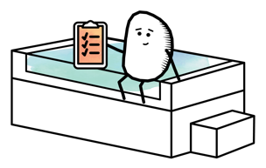
The Living-Donor Evaluation
The donor must complete a rigorous evaluation process
Complete testing process
    Blood work, urine testing
    Consultations with multidisciplinary team
    Abdominal scans, chest x-rays, electrocardiogram
    Kidney function test
    Stress test (if over 50 years old)
    Cancer Screenings
The evaluation is covered by recipient’s insurance
Notes:
The evaluation includes a number of tests, as well as meetings with a social worker and independent living donation advocate. The donor’s testing is covered by the recipient’s insurance.

Slide 24

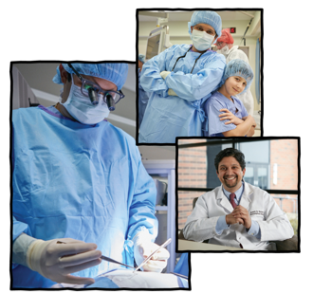
The Living Donor Surgery
This is a minimally-invasive surgery
lasts 3-4 hours at UPMC
The living donor is usually discharged
in 1-2 days after surgery
Living donors live longer than
the general population
Dr. Tevar, Director of Kidney and Pancreas Transplantation at UPMC
Notes:
Living donors undergo a minimally-invasive surgery technique called laparoscopic surgery. In most cases, the living donor is discharged after spending 1-2 day in the hospital. Living donors must be very healthy in order to donate – so healthy, in fact, that they live longer than the population in general.

Slide 25

Join the Living DoNATION
We are all on the same mission: to make a lifesaving
difference for those in need of an organ transplant
How can you help?
Talk about kidney about kidney health
and its risk factors
Make sure at-risk family and friends
are checked annually
Spread the word and tell others about
the benefits of living donation; the more
people who know, the more lives can be saved!
Notes:
Now that you know more about kidney health and treatments, we invite you to help us spread the word! Talk to your family and friends about kidney health, especially those who may be at higher risk. Maybe years from now, you hear about someone who needs a kidney transplant. We hope that you remember this information and can educate others about living donation as an option. Together, we can spread the words about the benefits of living donation and save more lives! For more information, check out the living donation dot com.

Slide 26

Notes:
Thank you so much for your time and attention today! Are there any questions?

Slide 27

A Second Chance at Life
Anthony and Eileen (7 minutes 27 seconds)
Omar and Clay (4 minutes 35 seconds)
Notes:
Let’s hear first-hand about living donation and transplant. [Introduce guest speaker(s) or video(s)]

